Slide 1
VI BASED HEMODYNAMIC MONITOR

Slide 2
INTRODUCTION
All of us recognize the terms such as 'Heart attack', 'Heart Failure', 'Coronary artery disease', and 'stroke', but few would know that these diseases are collectively a part of what is called Cardiovascular diseases.
Cardiology is actually a branch of medicine that deals with the problems and disorders of heart and some parts of the circulatory system.
For a person, it is important to keep the risk factors;
High blood pressure
Physical inactivity
Excessive consumption of tobacco/alcohol
Hereditary factors
Unhealthy diet
High level of cholesterol
Age

Slide 3





MOTIVATION
ABSTRACT
PROBLEM
STATMENT

Slide 4

MOTIVATION
The reality that cardiovascular diseases are the leading cause of death around the world. As estimated by the World Health Organization(WHO),the count is 17.9 million or 31% of death case around the world.
This trend is supporting the scientific activity in the direction of developing new cardiovascular monitoring applications is constantly intensifying, like
SENSORS USED.
DATA ACQUISTION ELEMENT.
USER INTERFACE.
SIGNAL ALGORITHMS.

Slide 5
PROBLEM STATEMENT
When it comes to a layman, until he/she has a heart attack, he would not believe that there is something wrong with his heart. However the first step towards getting rid of cardiovascular or any abnormal condition in his/her body. One should always have an eye on their physical condition.
So one can monitor his / her hemodynamic parameters Such as,
Body temperature.
Beats per minutes(BPM).etc
--If one is suffering from any of the abnormal condition , there must be any abnormal values for this parameters and data analysis from the graph .

Slide 6
ABSTRACT
The system “VI BASED HEMODYNAMIC MONITOR” is developed to assist patients and doctors in health care. An Arrhythmia is an abnormal heart rhythm. It may be so brief that it doesn’t change the overall heart rate, but it can cause the heart rate to be too slow or too fast. When arrhythmias are severe or last long ,the heart may not be able to pump enough . This may cause the patient to feel tired or make him pass out . An electrocardiogram is often used to diagnose arrhythmias. This system meant to acquire ECG ,PPG,BODY TEMPERATURE data from the patient and analyze it to detect and classify its anomalies and abnormalities .

Slide 7








HARDWARE USED
PPG
ARDUINO
GSM
ECG
LM35

Slide 8
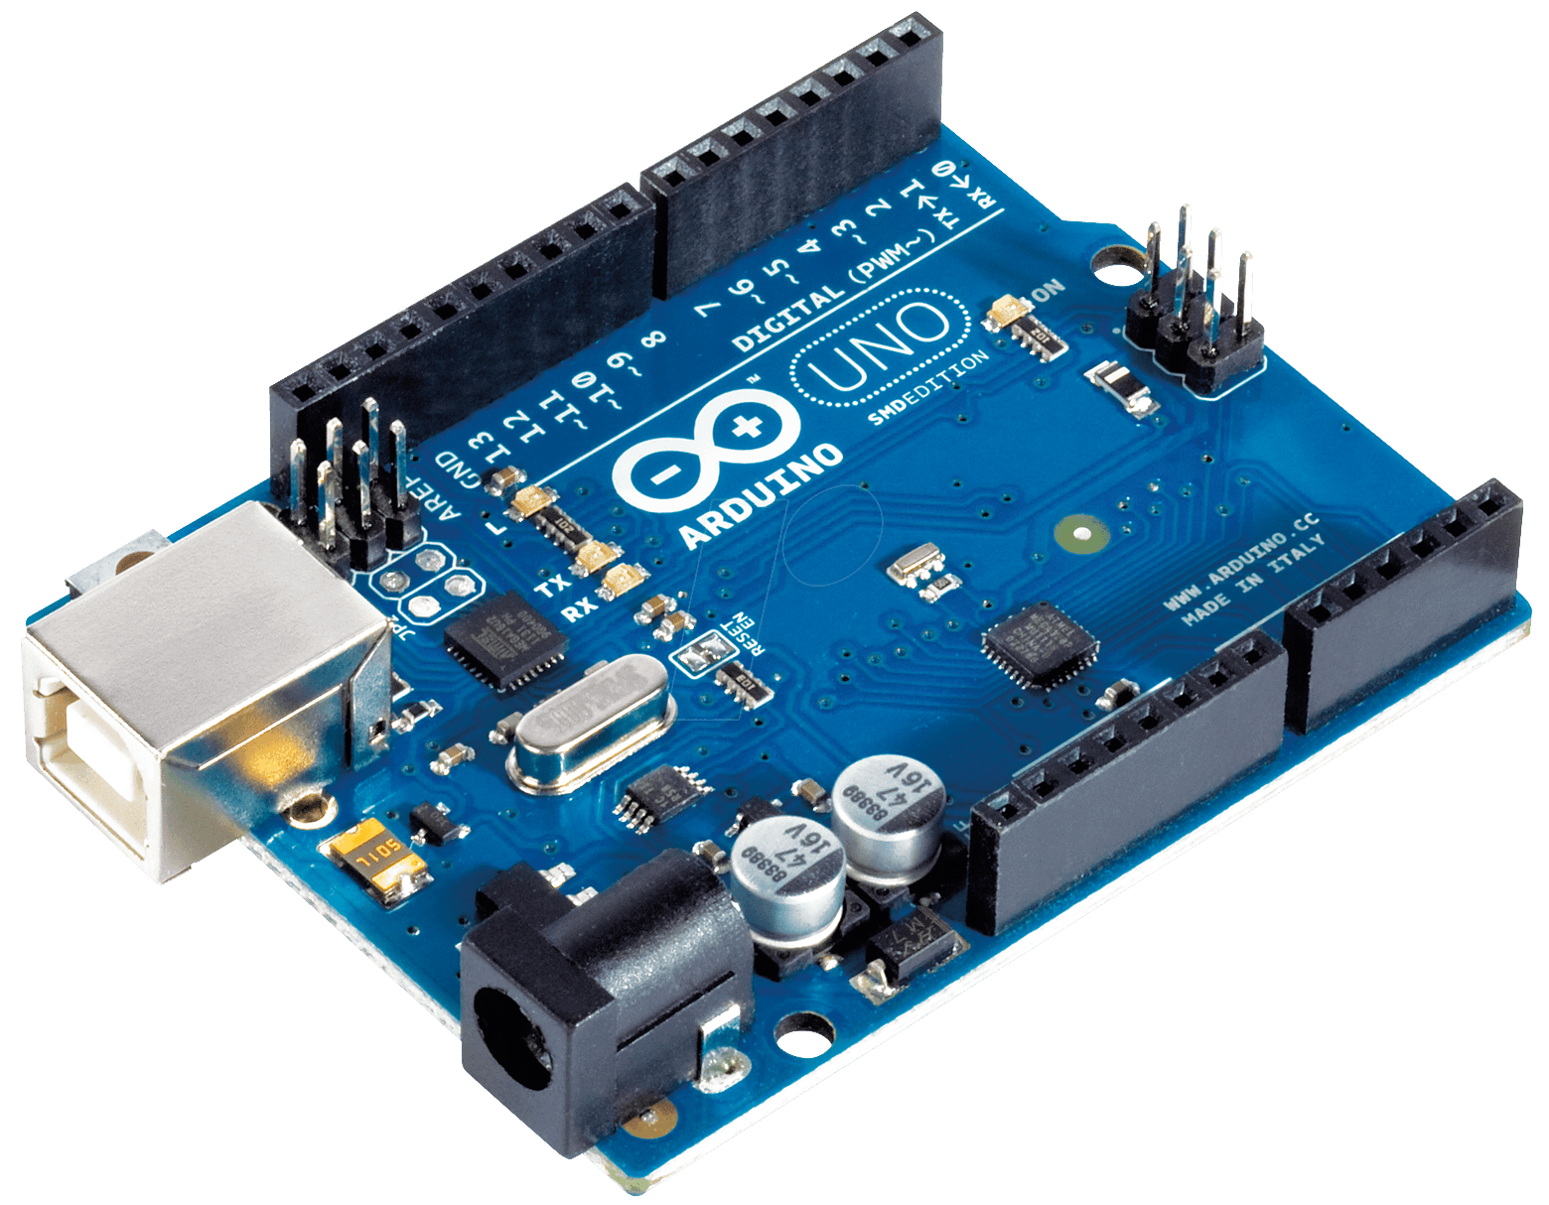
ARDUINO UNO
The Arduino Uno is a type of Arduino board that is provided as an open-source board that uses an ATmega328p microcontroller in the board. The Arduino Uno contains a set of analog and digital pins that are input and output pins which are used to connect the board to other components. There are a total of fourteen I/O pins placed inboard in which six are analog input pins. The board has a USB connection that can be used to a power supply to the board. The board is used for electronics projects and used to design the circuit.

Slide 9
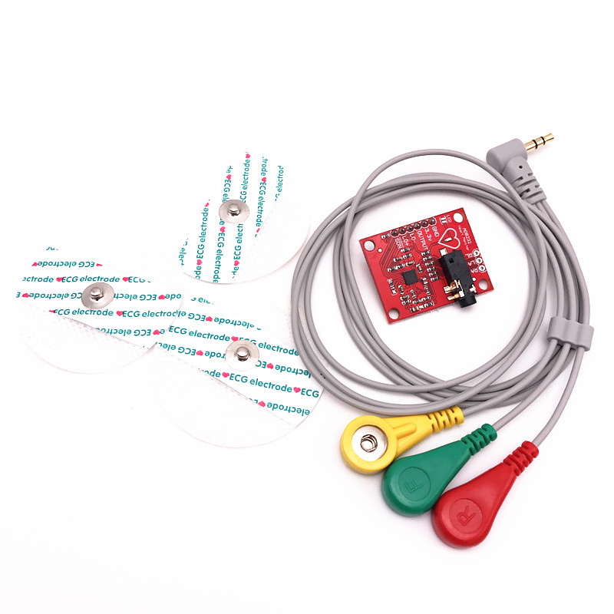
AD8232 ECG MONITOR SENSOR
AD8232 ECG Module integrated with AD8232 IC from Analog Devices, which is a single-chip designed to extract, amplify, and filter biopotential signals for biopotential measurement applications (like ECG and others). ECGs can be extremely noisy so that the AD8232 Single Lead Heart Rate Monitor acts as an op-amp to help obtain a clear signal from the PR and QT Intervals easily.

Slide 10
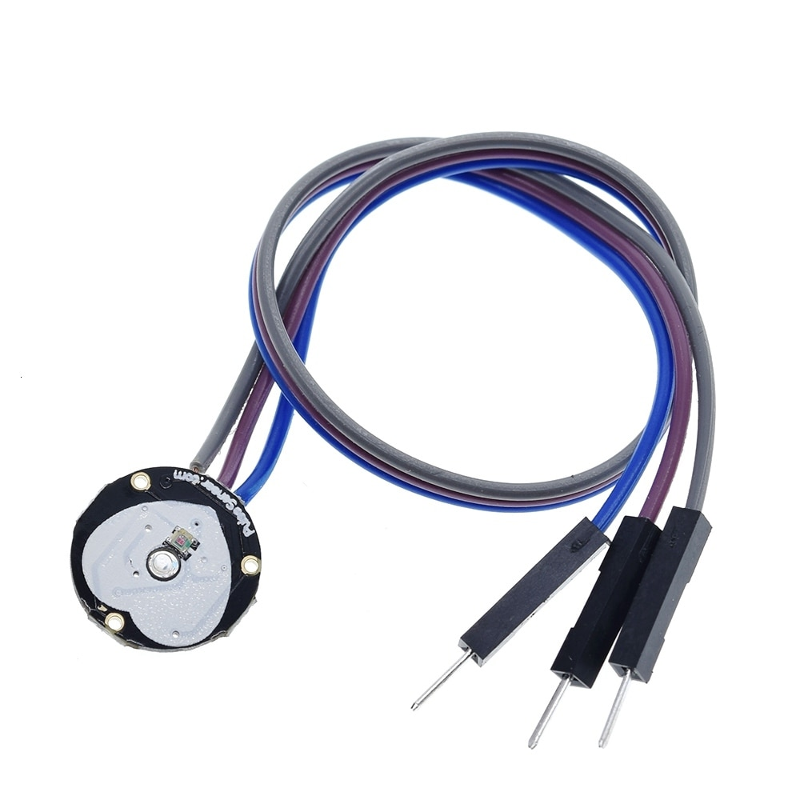
PHOTOPLETHYSMOGRAM SENSOR
Heart rate pulse sensor amped is a such type of sensor which is mainly used for sensing heartbeat rate. Normally it is very difficult task to measure the exact heartbeat rate, but this have become so much easy with the help of this pulse sensor amped. If we talk about heartbeat, then heart beat is a periodic signal that is produced by any software or hardware system for giving intimation to normal of working of any system. For measuring this periodic intimation signal, so many sensors have been using currently in market but here we shell only talk about pulse sensor amped.

Slide 11
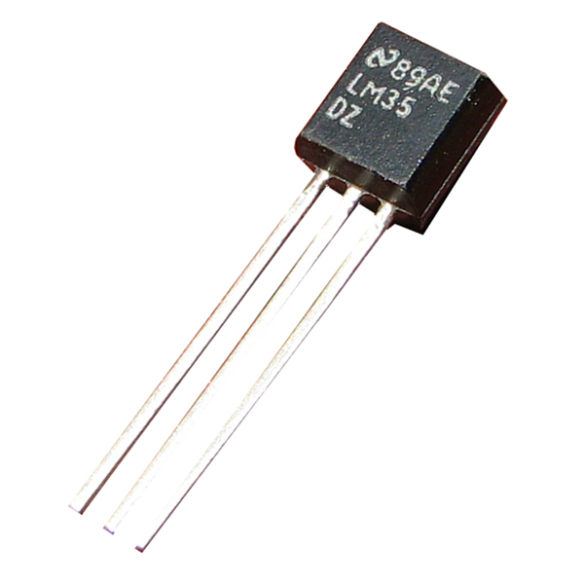
LM35 TEMPERATURE SENSOR
An LM35 temperature sensor is an integrated circuit that generates an analog output signal equivalent to the instantaneous temperature. One advantage of LM35 is that it doesn’t need external calibration to work. Moreover, its outer coating prevents it from self-heating, and can anyone can afford it since it’s cost-effective.

Slide 12
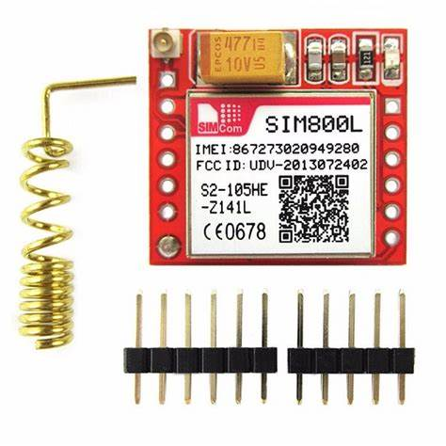
GSM SIM800L
The SIM800L is a GSM module from Simcom that gives any microcontroller GSM functionality, meaning it can connect to the mobile network to receive calls and send and receive text messages, and also connect to the internet using GPRS, TCP, or IP. Another advantage is that the board makes use of existing mobile frequencies, which means it can be used anywhere in the world.

Slide 13



SOFTWARE USED
LABVIEW
ADRIUNO IDE
NI - VISA

Slide 14

LABVIEW
LabVIEW is a programming environment in which you will be able to create programs using graphical notation. A graphical notation is nothing but a process where you will be connecting functional nodes with wires which ultimately depicts how the data flows.

Slide 15

ADRIUNO IDE
The arduino software (IDE) is an open source software, which is used to programme the Arduino boards, and is an integrated development environment, devlopped by arduino.cc. Allow to write and upload code to arduino boards. And it consiste of many libraries and a set of examples of mini projects.

Slide 16
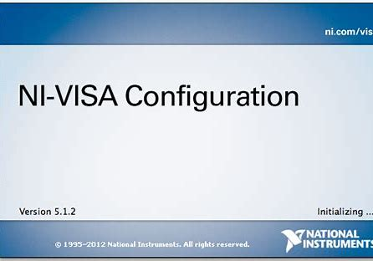
NI - VISA
NI-VISA is an API that provides a programming interface to control Ethernet/LXI, GPIB, serial, USB, PXI, and VXI instruments in NI application development environments like LabVIEW, LabWindows/CVI, and Measurement Studio. The API is installed through the NI-VISA driver.

Slide 17
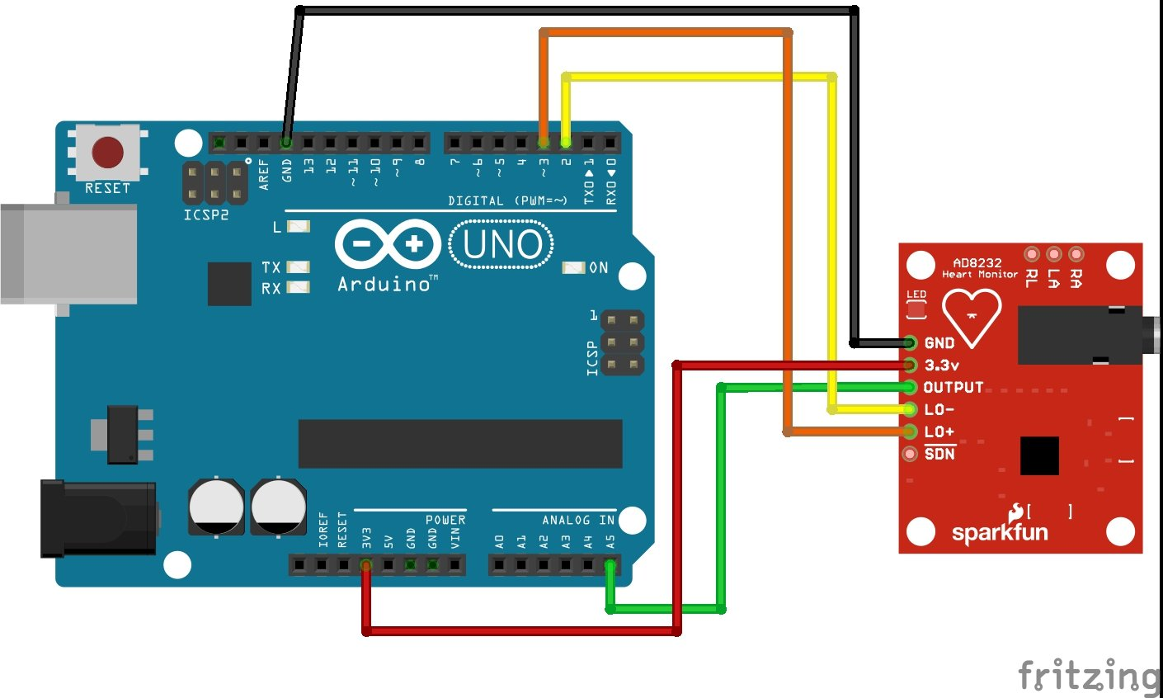
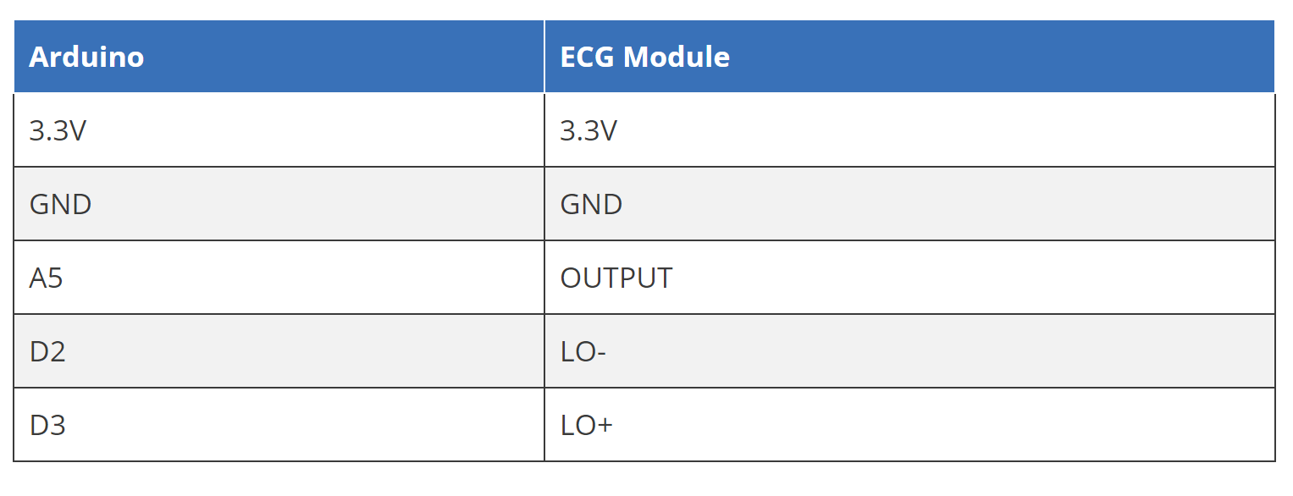
CIRCUIT DIAGRAM- ECG

Slide 18
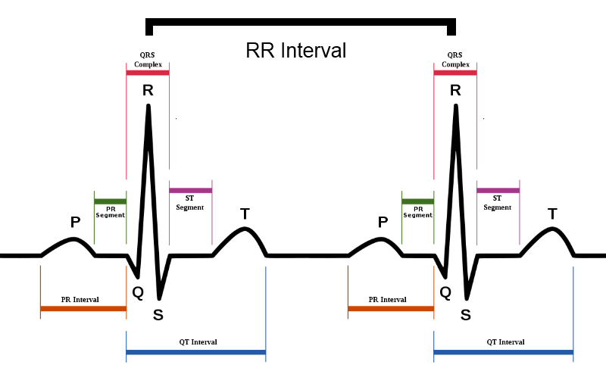
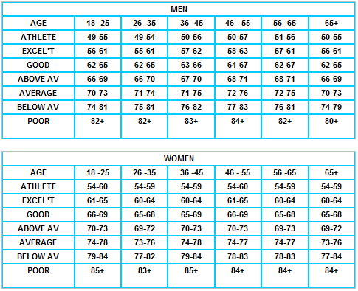
EXPERIMENTAL DATA:

Slide 19
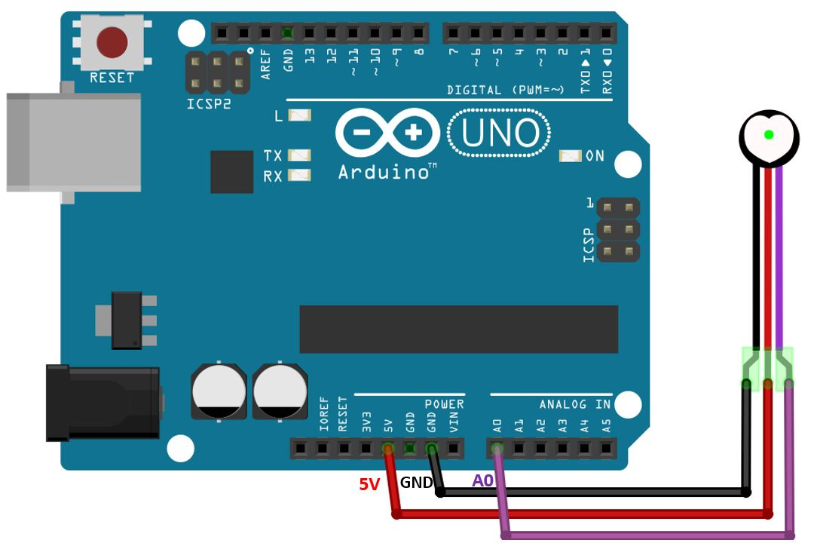
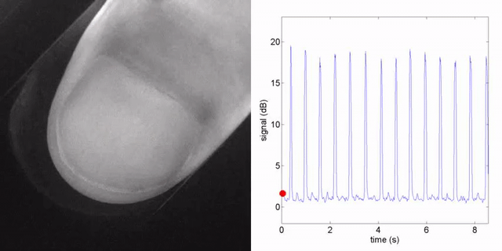
CIRCUIT DIAGRAM - PPG

Slide 20
BLOCK DIAGRAM
GSM
ALERT
CALL & MESSAGES
DATAS FROM ECG,PPG,BODY TEMPERATURE
PATIENT
ECG
EXTARCTION
CIRCUIT
LABVIEW
PATIENT
DATABASE
PPG
ECTRACTION CIRCUIT
TEMPERATURE EXTRACTION CIRCUIT

Slide 21
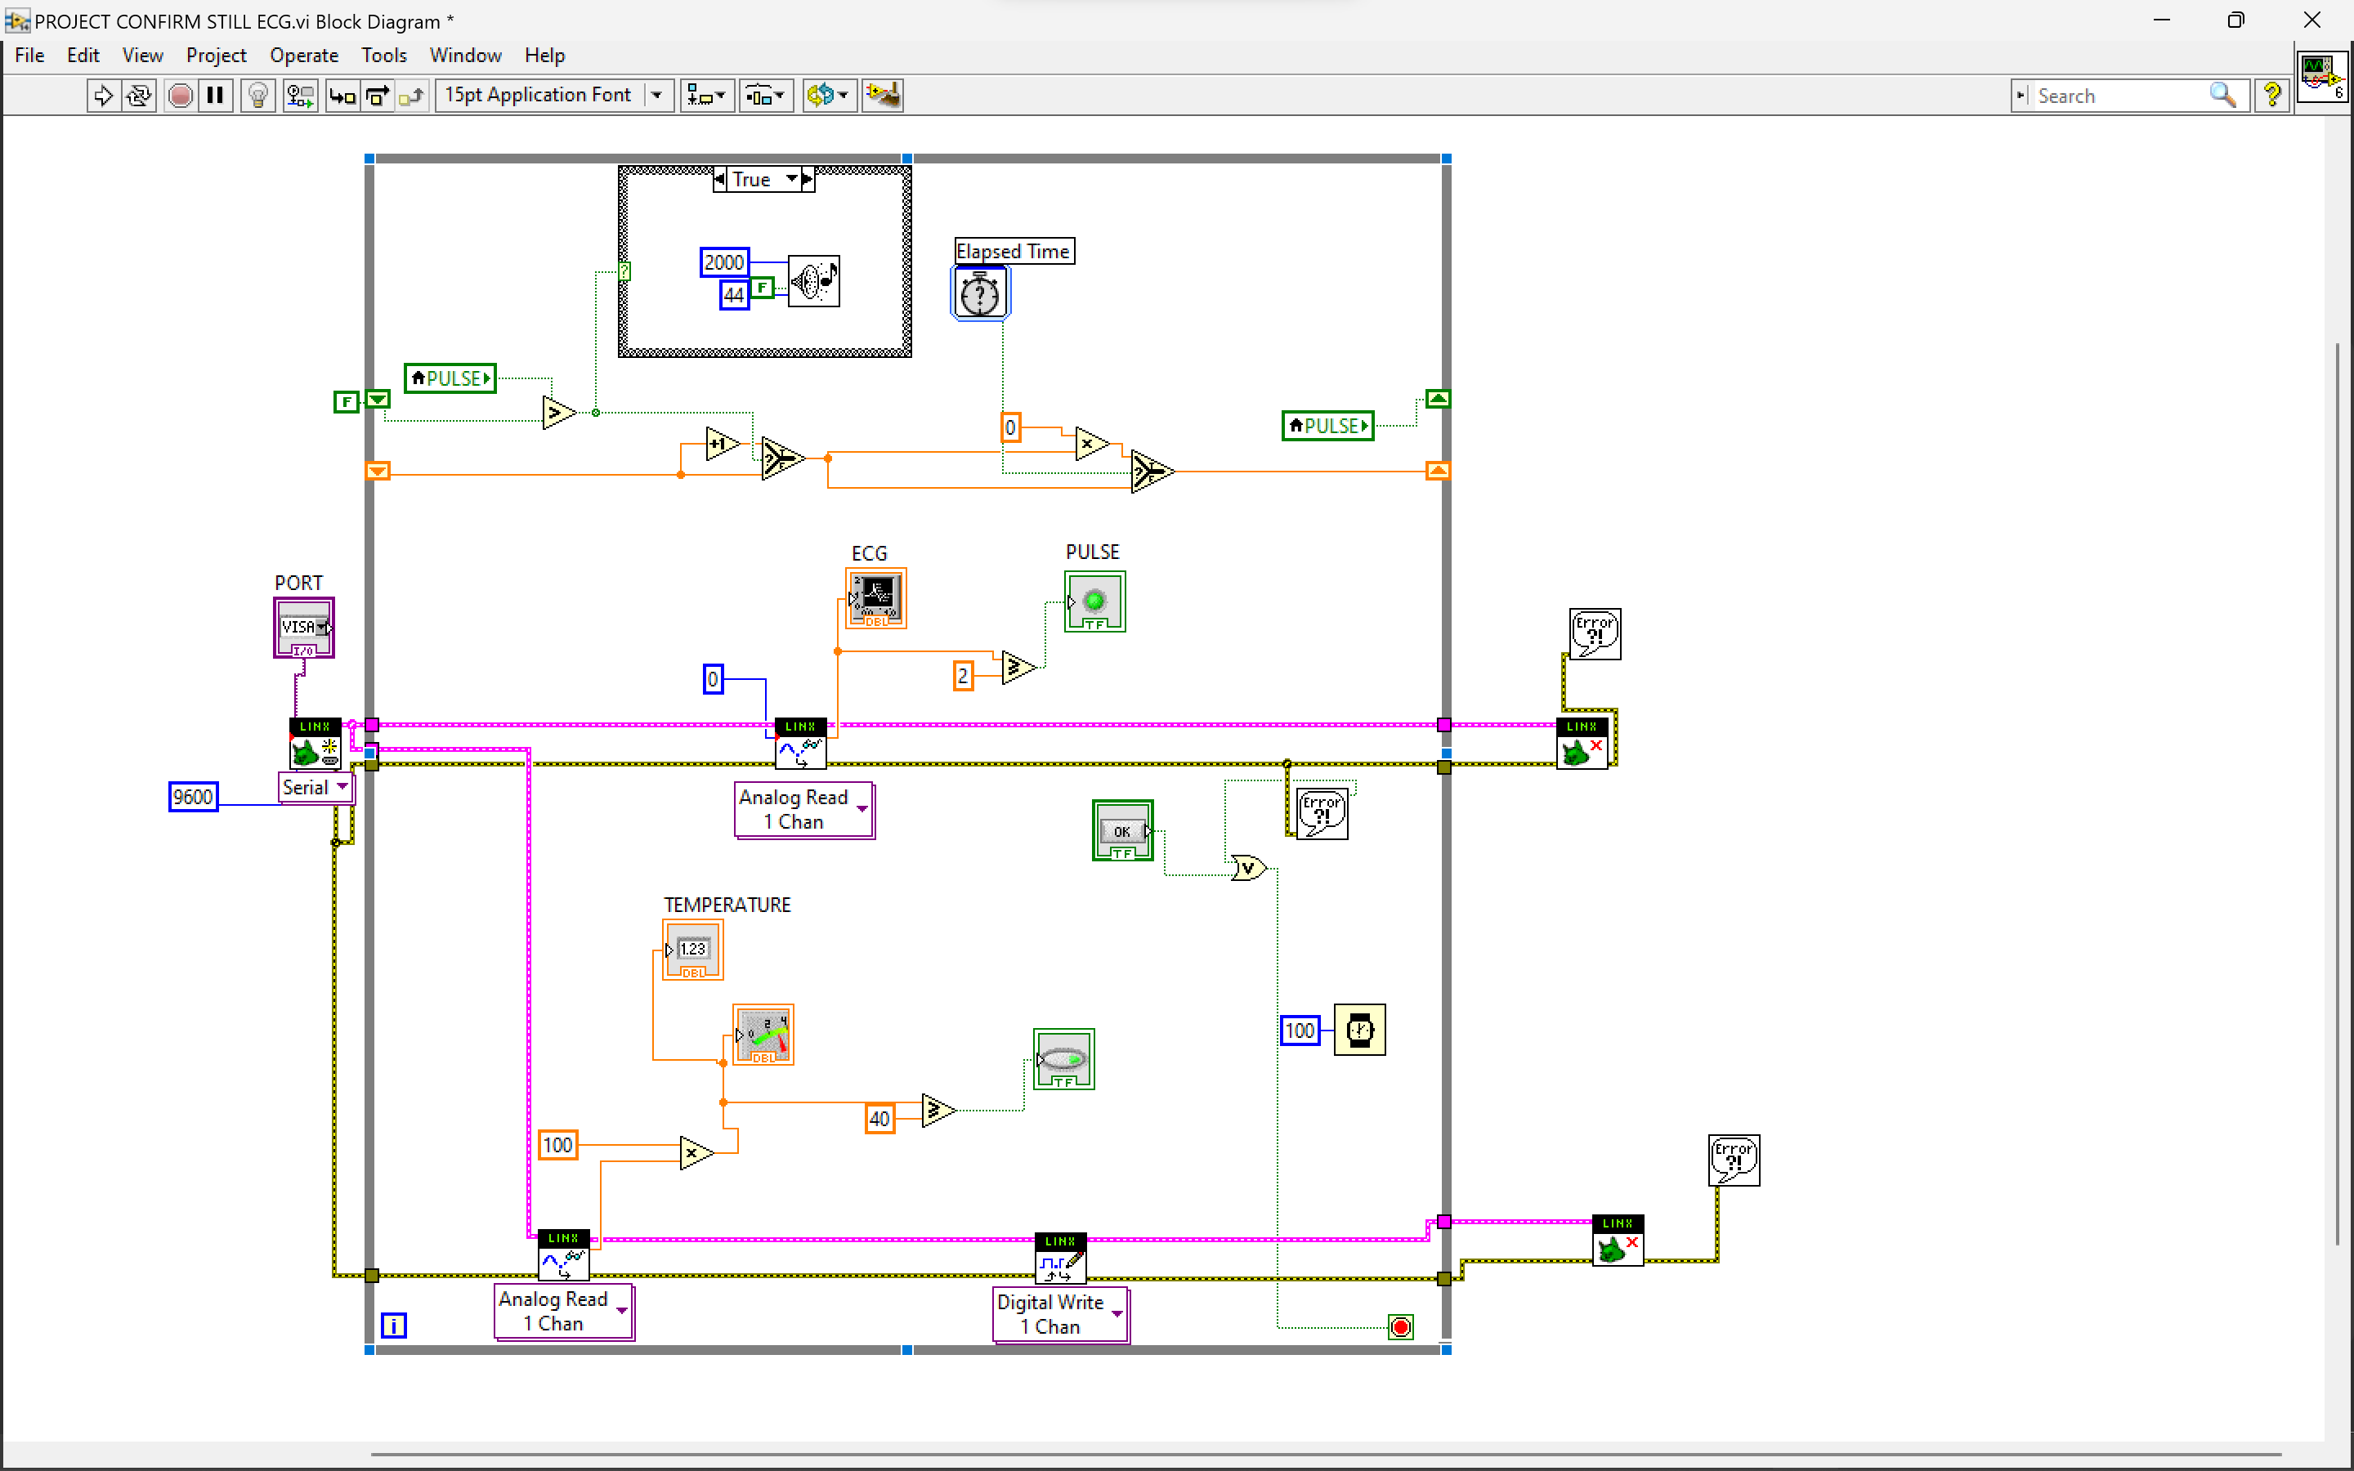
LABVIEW BLOCK DIAGRAM

Slide 22
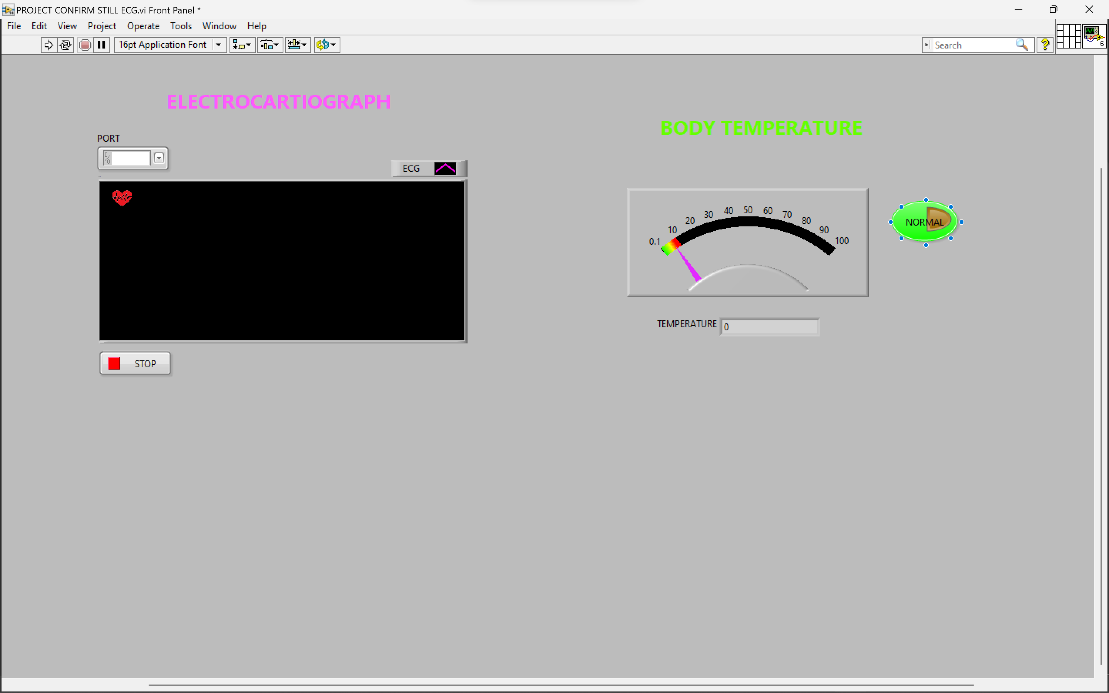
LABVIEW FRONT PANEL

Slide 23
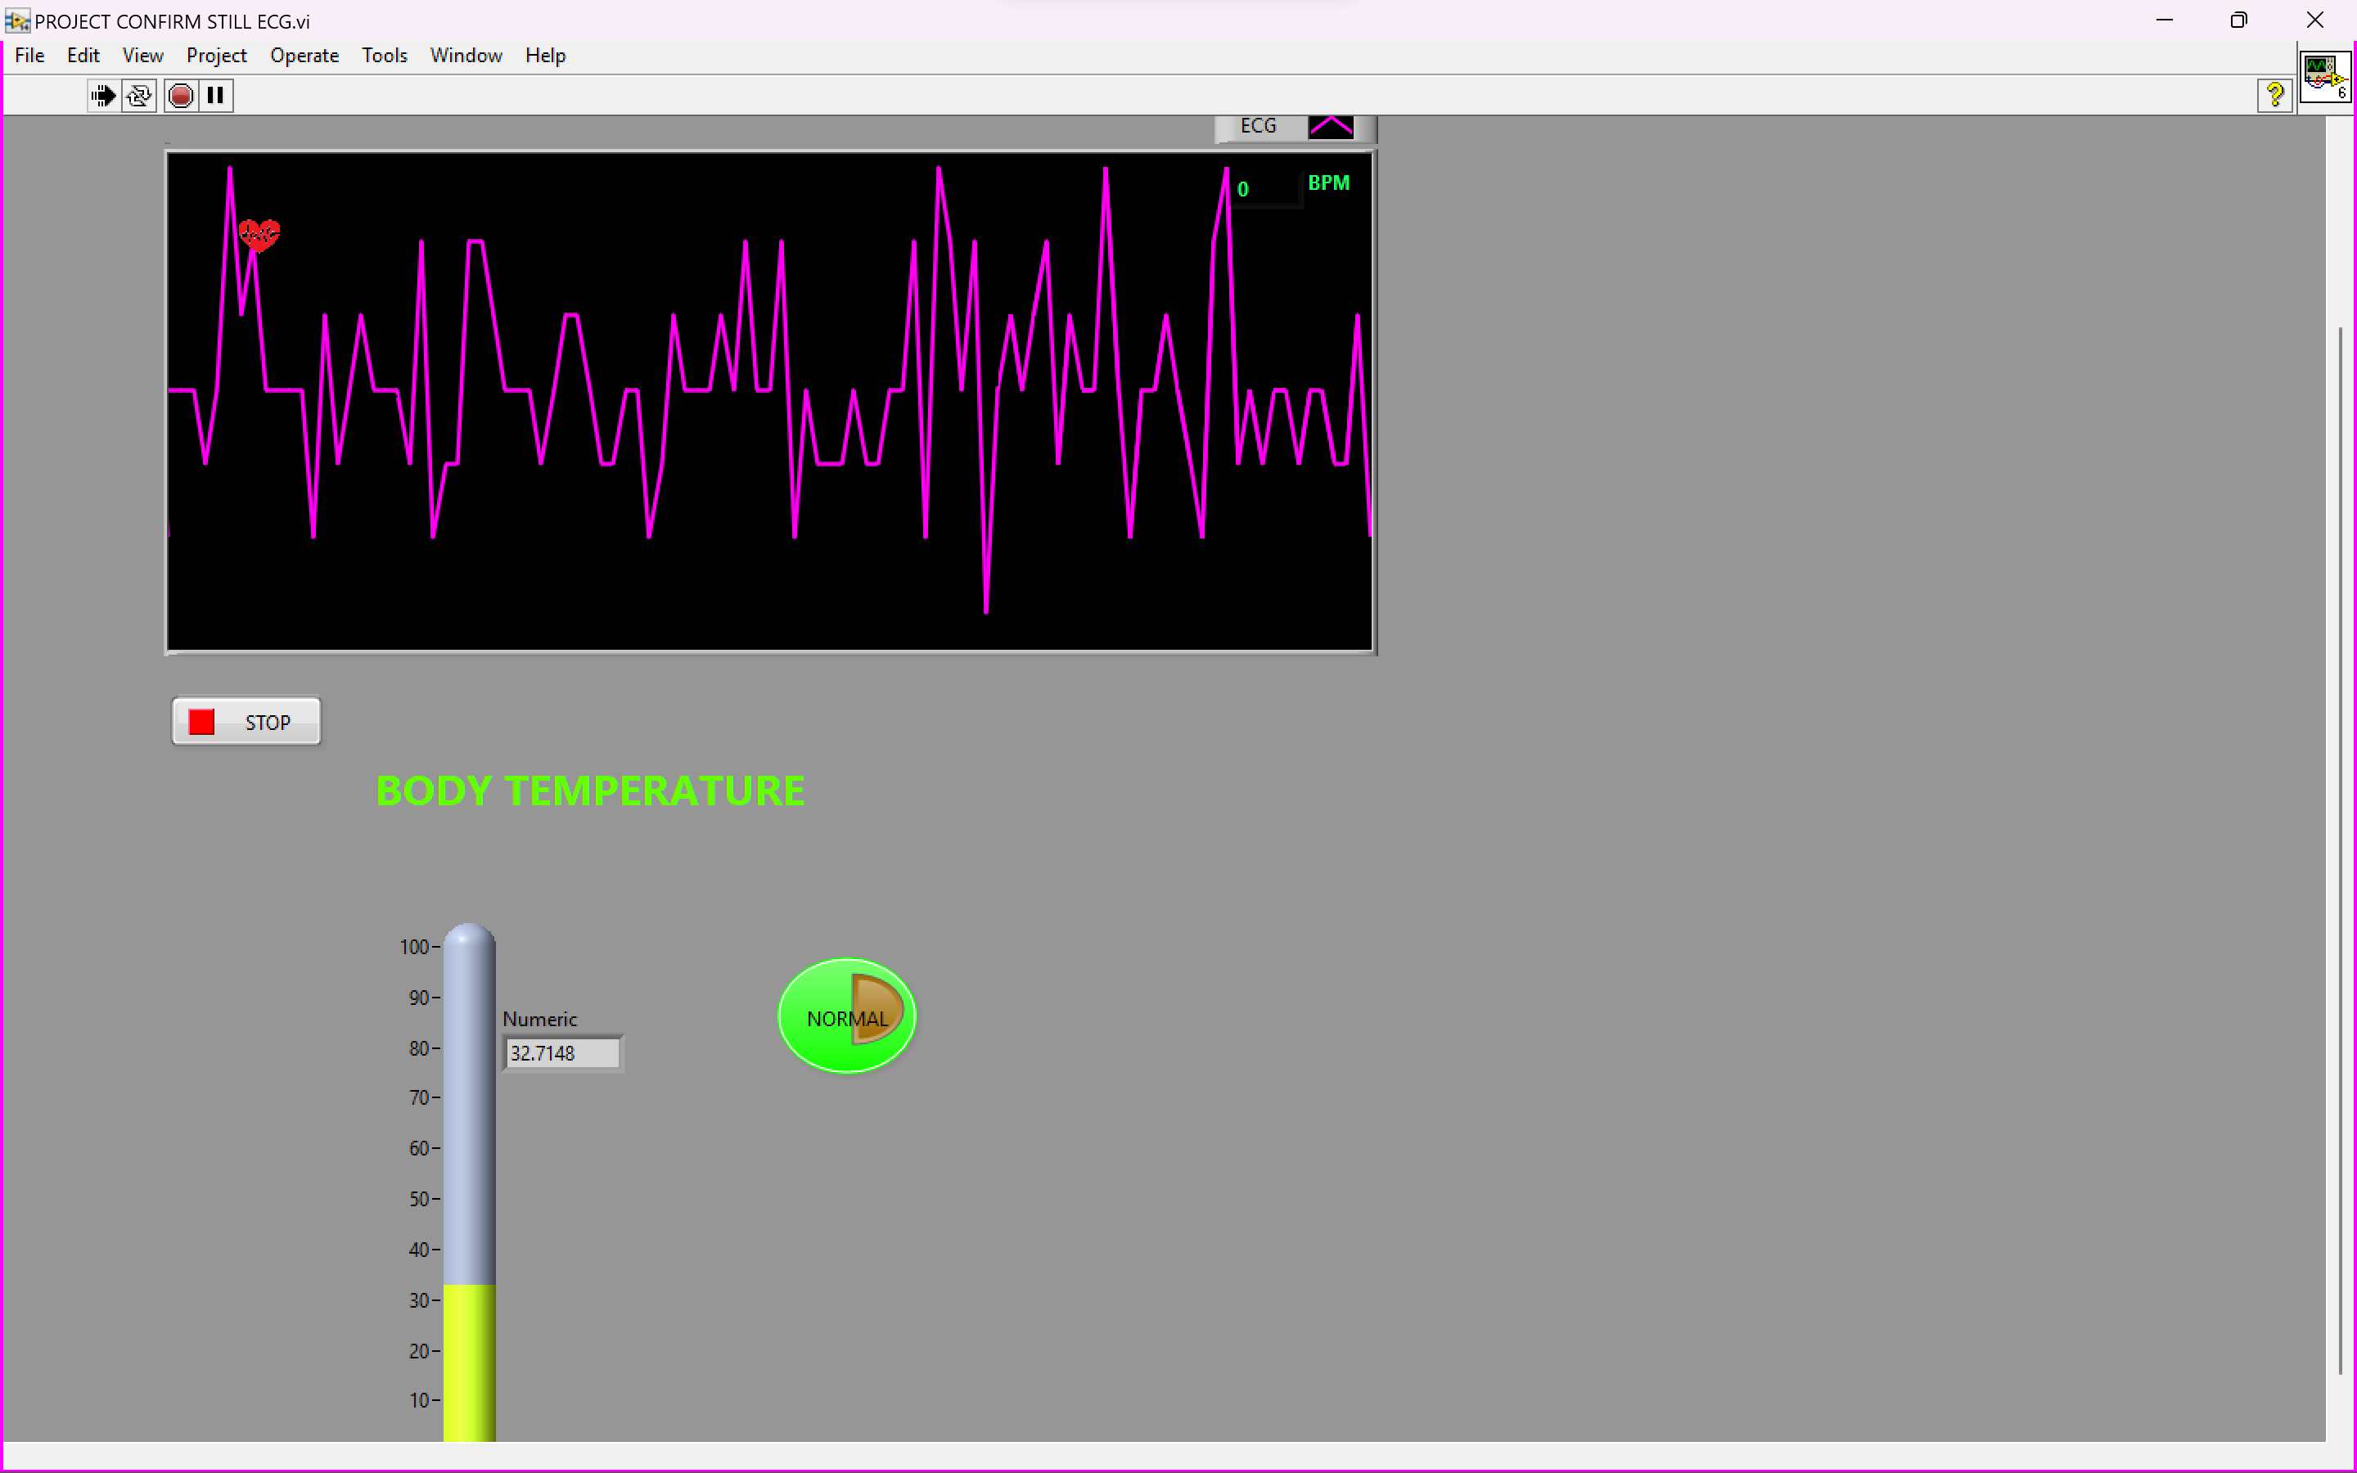
RESULT

Slide 24
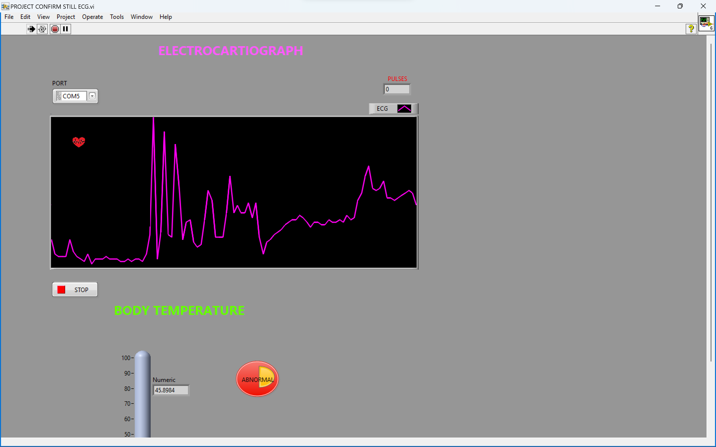
RESULT

Slide 25
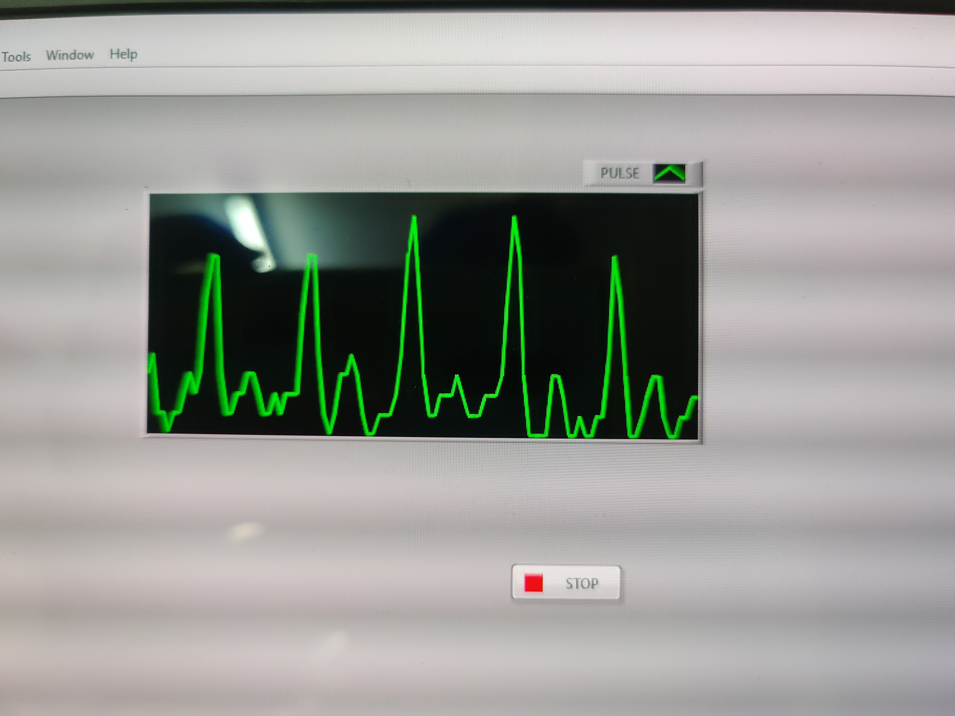
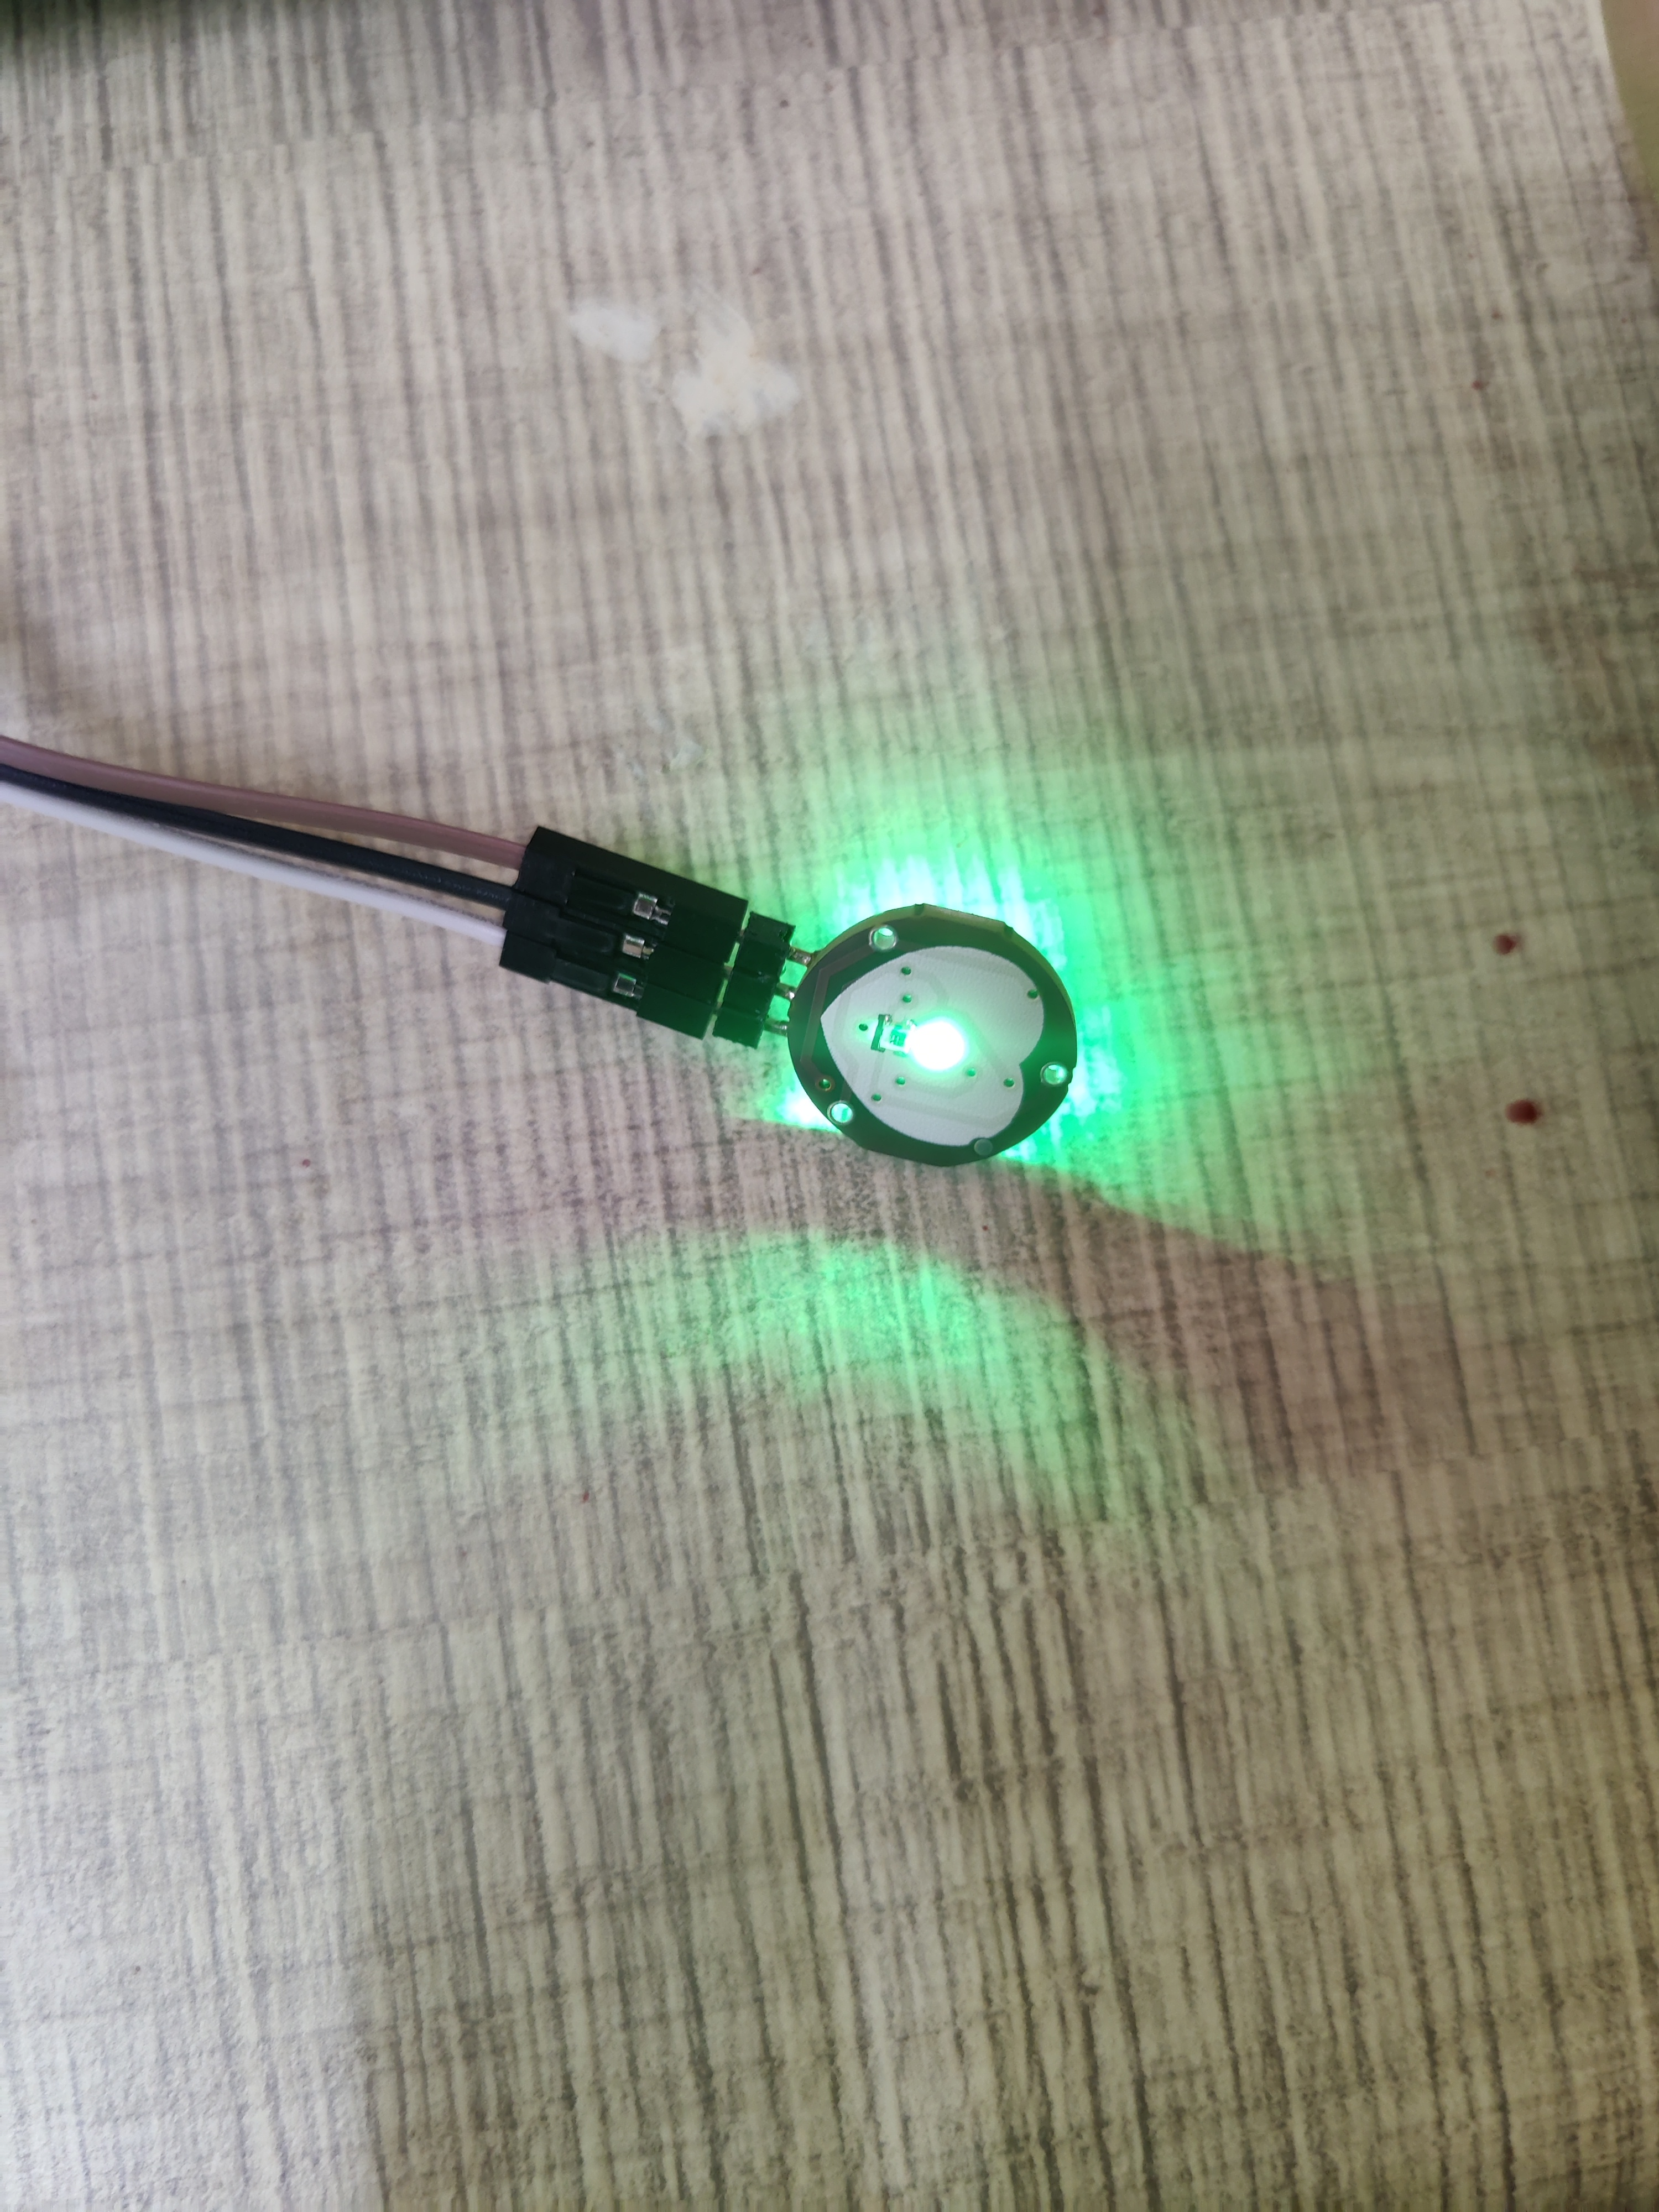
RESULT

Slide 26
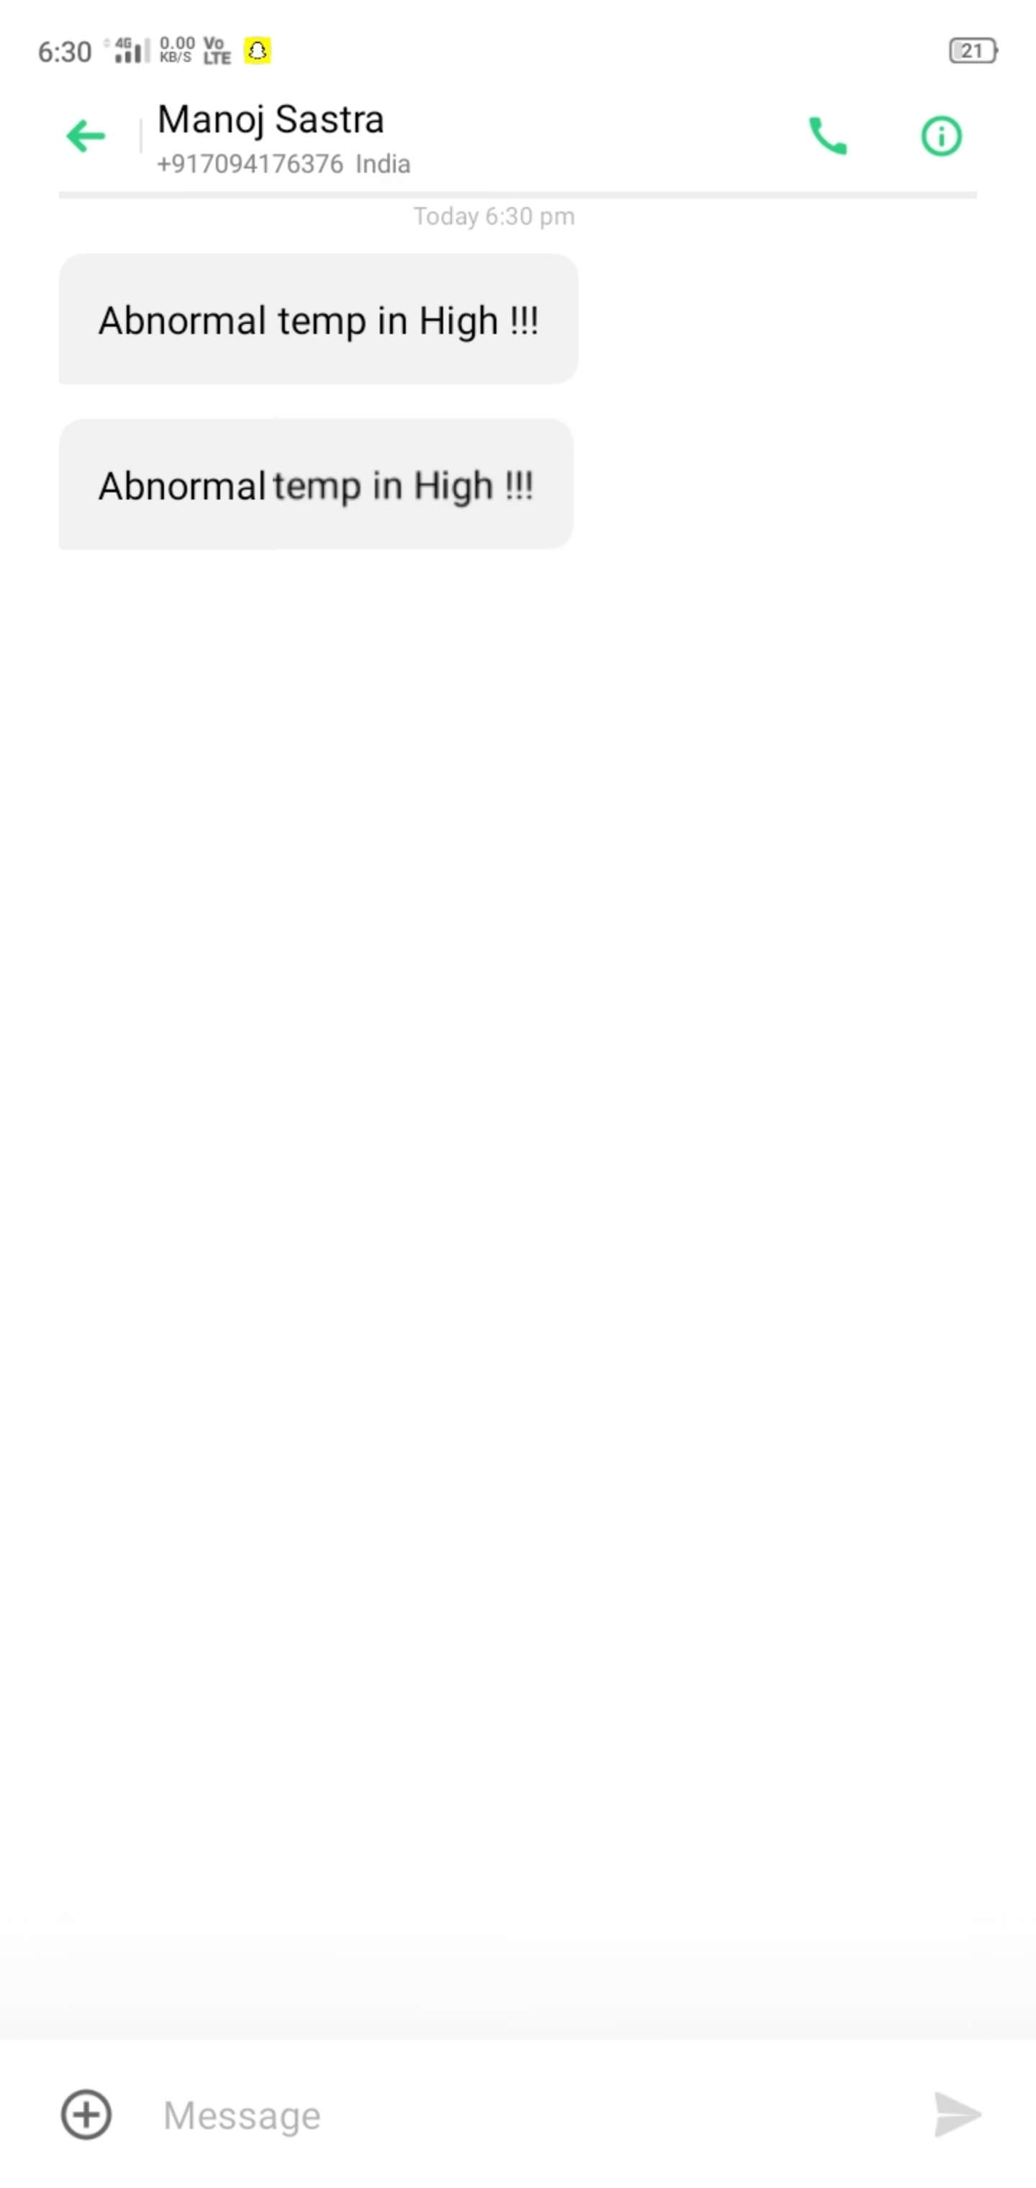
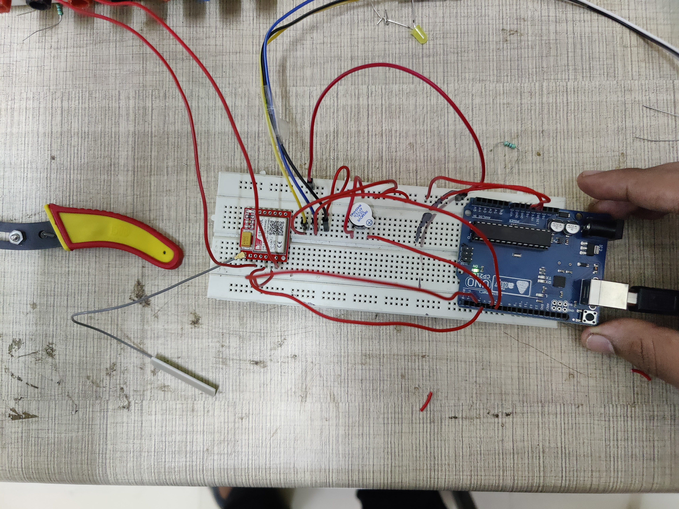
RESULT

Slide 27
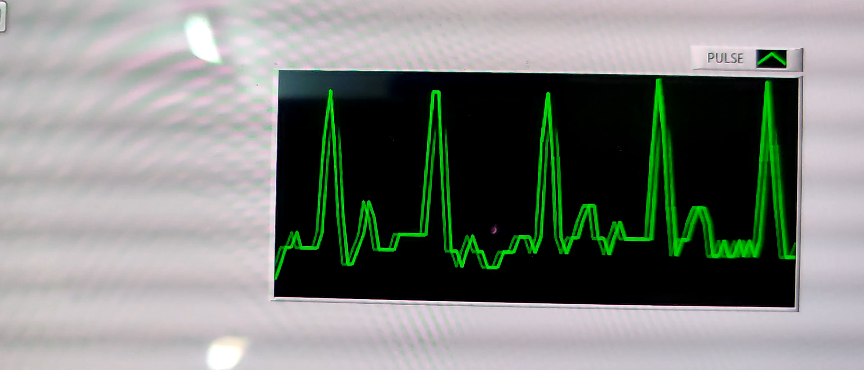
RESULT

Slide 28
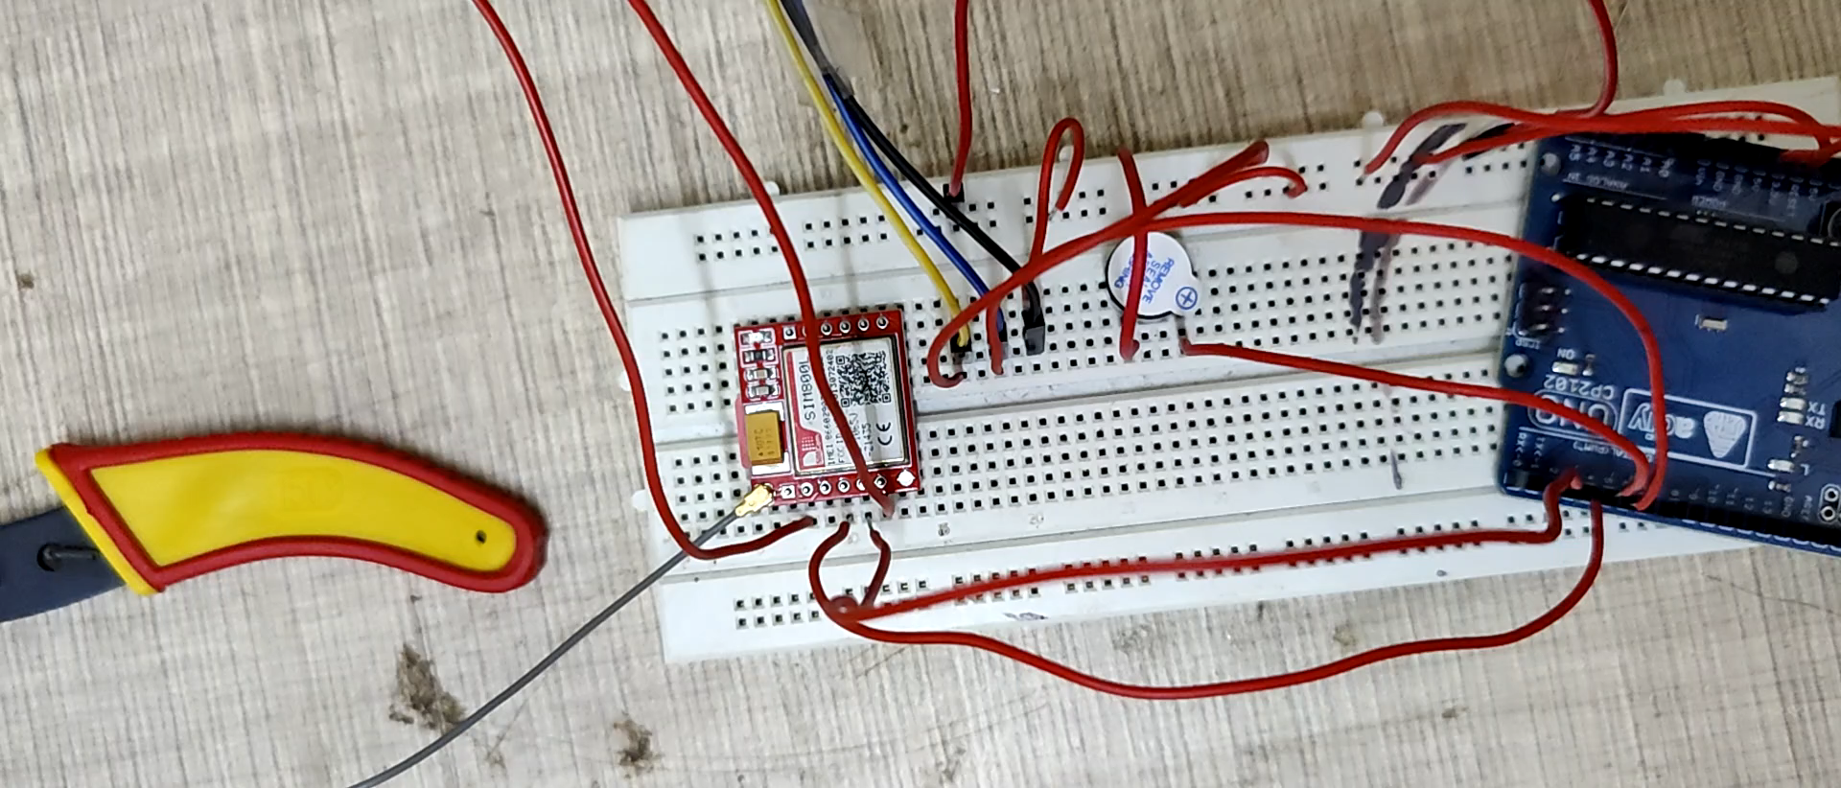
RESULT

Slide 29
REFERENCES
A Mhatre, S Pai, N Rajput Volume 111, Issue IX,
September 2014(Page no. 128-131): Temporal Analysis
of ECG usin LabVIEW
John A Kastor, —Cardiac Arrhythmiasll, University of
Maryland,Baltimore, Maryland, USA.
Elizabeth M. Cherry and Flavio H. Fenton, —Heart
Structure,Function and Arrhythmiasll, Department of
Biomedical Sciences,College of Veterinary Medicine,
Cornell University.http://thevirtualheart.org
H. Sahool and K. Biswal, "Patient monitoring system
for cardiovascular patient with body temperature using
lab VIEW," International Journal of Engineering
Research and Development, vol. 6, no. 8, pp. 27—30,
2013.

Slide 30
REFERENCES
C. Saritha, V. Sukanya, and Y. Narasimha Murthy,
"ECG signal analysis using wavelet transforms,"
Bulgarian Journal of Physics, vol. 35, Article ID
13100157, pp. 68-77, 2008.
S. N. Van, D. T. Quang, and G. N. Hoai, "Development of A Low-Cost
Arduino-Based 12-Lead ECG Acquisition System And Accompanied
Labview Application," Int. J. of Eng. and Adv. Technology, vol. 9, pp.
1641 - 1648, Oct. 2019.
Villanueva-Miranda, H. Nazeran, and R. Martinek, "CardiaQloud: A
Remote ECG Monitoring System Using Cloud Services for eHealth
and mHealth Applications," Proc. of IEEE 20th Int. ConC on E-Health
Networking, Applic. and Serv., HEALTHCOM, pp. 1 — 6, Sept. 2018.
N. Celik, N. Manivannan, and W. Balachandran, "Evaluation of a
Behind-the-Ear ECG Device for Smartphone Based Integrated
Multiple Smart Sensor System in Health Applications," J. of Adv.
Comp. Scie. and App., vol. 7, pp. 409 — 418, Jul. 2016.

Slide 31
REFERENCES
S. Mahdiani, V. Jeyhani, M. Peltokangas, and A. Vehkaoja, "Is 50 Hz
high enough ECG sampling frequency for accurate HRV analysis?,"
Proc. of IEEE 37th Annual Conf on Eng. in Medicine and Biology Soc.,
EMBC, pp. 5948 - 5951, Aug. 2015.
A. Dihn, L. Luu, and T. Cao, "Blood Pressure Measurement Using
Finger ECG and Photoplethysmogram for IoT," Proc. of Int. Conf on
Dev. Of Biomedical Eng. in Vietnam - IFMBE6, Springer, vol. 63, pp.
83 - 89, Sep. 2017.
V. Ordodi, L. Måtiu-lovan, G. Bärbulescu, D. Bonciog, D. Nistor, D.
Crisnic, and G. Tänasie, "Experimental Elecrophysyological device
for the appreciacion of the cardiac systolic function — a pilot study,"
UMFT J. Physiology (Fiziologia), vol. 29, issue 2, pp. 4 — 7, 2019.
A. Ciuffoletti, "Design of an Open Remote Electrocardiogram (ECG)
Service," MDPI Future Inter. J., vol. 11, issue 4, pp. 1 — 19, Apr. 2019.

Slide 32
REFERENCES
A. Polo, P. Narvaez, and C.R. Algarin, "Implementation of a Cost-
Effective Didactic Prototype for the Acquisition of Biomedical
Signals," MDPI Electronics J., vol. 7, issue 5, pp. I — 23, May 2018.
C. Saritha, V. Sukanya, and Y. Narasimha Murthy,
"ECG signal analysis using wavelet transforms,"
Bulgarian Journal of Physics, vol. 35, Article ID
13100157, pp. 68-77, 2008.

